Slide 1
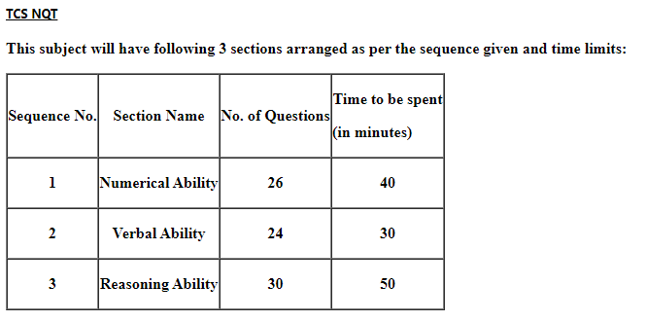

Slide 2
Syllabus
Numerical ability:
Data Interpretation
Statistics
Time and Work
Mensuration
Number System
Time, Speed and Distance
Ratio and Proportions
Linear Equations
Simple Interest and Compound Interest
Percentages
Profit and Loss
Simplification – Fractions and BODMAS
Surds and Indices

Slide 3
Reasoning Ability:
Attention to detail
Unboxing a cube
Data Arrangements
Cuts and unfolds
Venn diagrams
Blood relations
Data Interpretation
Visual reasoning
Syllogisms
Statements and Assumptions
Rule based decision making
Decision tables
Number series
Analogy
Verbal Ability:
Reading Comprehension
Passage Completion - Missing words (Cloze passage)
Passage Completion - Missing sentences
Error spotting
Prepositions
Sentence Completion
Prepositions
Tenses
Knowledge of Formal/Informal language
Sentence improvement
Parajumbles
Knowledge of spelling

Slide 4
FIND THE CUBE ROOT OF
1. 328509
2. 50653
3. 970299
4. 1442897

Slide 5
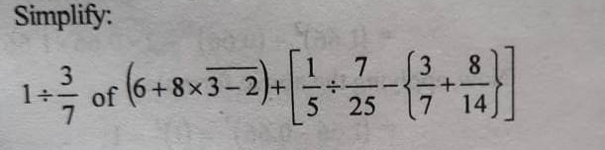

Slide 6
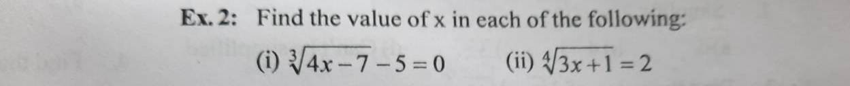

Slide 7
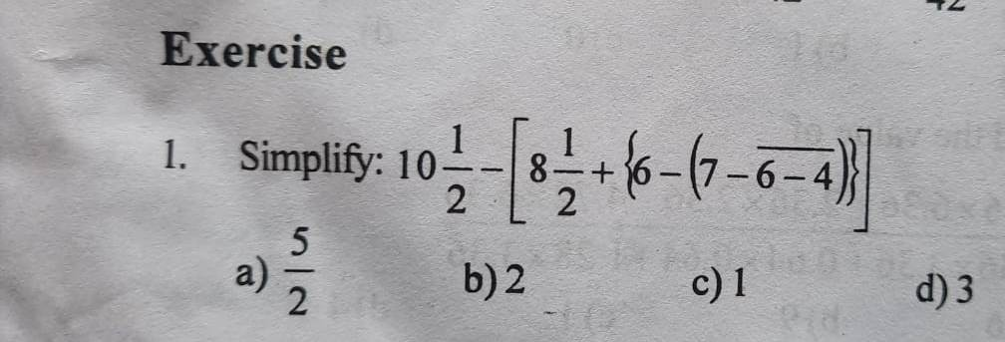

Slide 8
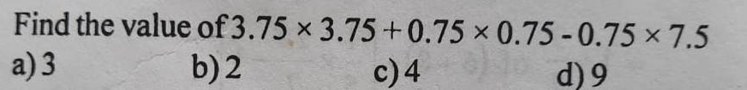

Slide 9
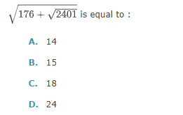

Slide 10
STATISTICS (2-4)Marks

Slide 11
Mean
Median
Mode
Range
Variance
Standard Deviation
Coefficient of Variation

Slide 12
Q What is the mean of the mode and the median of the following data?
8,6,8,7,8,6,8,7,6

Slide 13
Q Find the standard deviation of
11,7,10,13,9

Slide 14
Q What is median , mode and mean of the following data?
9,5,8,9,9,7,8,9,8

Slide 15
Q Find the range of the following data?
2,1,2,3,5,4,7,3,5,2,4

Slide 16
Q Find the standard deviation of
10,11,12,9,8

Slide 17
Q What is median of the following data?
5,3,6,9,11,19,1

Slide 18
The mean of a distribution is 21 and the standard deviation is 7. What is the value of the Coefficient variation in terms of percentage?

Slide 19
If the standard Deviation of a population is 6.5,what would be the population variance ?

Slide 20
The median of the following numbers arranged in ascending order is 2.5, then find the value of x ?
0,0,1,1,2,2,x,3,3,4,5,7

Slide 21
The variance of a set of data is 121. Then find the standard deviation of the data is ?

Slide 22
Q What is median of the following data?
-3,4,0,4,-2,-5,1,7,10,5 ?

Slide 23
What is the standard deviation of the data given below?
10, 28, 13, 18, 29, 30, 22, 23, 25, and 32.
A. 7.7
B. 7.0
C. 49.0
D. 6.2

Slide 24
What is the standard deviation of the data given below?
82, 93, 98,89,88

Slide 25
Q.) What is the mean of the mode and the median of the following data?
12, 28, 26, 27, 17, 16, 22, 25, 15, 16, 11
A. 16.5
B. 16
C. 17
D. 16.3

Slide 26
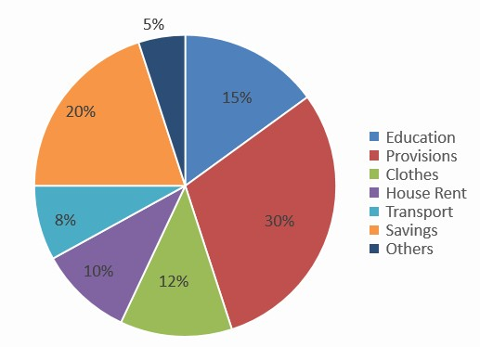
Q1. The following pie chart shows the expenditure in percentage on various items and savings of a family during a month.
What is the monthly expenditure on education if the monthly expenditure on clothes is 2400?
A. Rs. 3500
B. Rs. 3000
C. Rs. 6000
D. Rs. 4000

Slide 27
Q2. A can finish a work in 16 days and B can finish the same work in 20 days. After A had worked for 4 days, B also joined with A to finish the remaining work. In how many days will the remaining work be finished?
A. 8 1/9 days
B. 6 ⅔ days
C. 8 8/9 days
D. 6 ⅓ days

Slide 28
Q3. If mean of 29 observations is 33 and on adding one more observation the mean becomes 34
What is the value of the 30th observation?
68
34
55
63

Slide 29
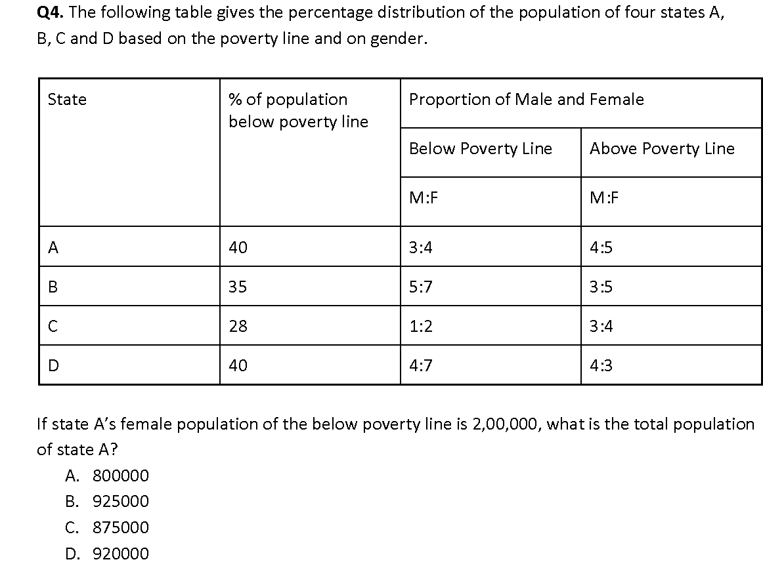

Slide 30
. Raju lends Rs. 3000 to Bharath and a certain sum to Charan at the same time at 6% per annum simple interest. If after 5 years, Raju altogether receives Rs. 1650 as the interest from Bharath and Charan, what is the sum lent to Charan?
A. Rs. 2500
B. Rs. 2750
C. Rs. 3250
D. Rs. 3300

Slide 31
LOGICAL REASONING

Slide 32
1.Statements: All orchids are flowers. Some orchids are beautiful. Conclusions: :I. Some flowers are beautiful. II. All beautiful are flowers.
Neither conclusion I nor II follows.
Both conclusions I & II follow.
Only conclusion II follows.
Only conclusion II follows

Slide 33
Neither conclusion I nor II follows.
Both conclusions I & II follow.
Only conclusion II follows.
Only conclusion II follows
3.Statements: All new are modern. Some modern are old. All old are gold. Conclusions: I.Some new are old is a possibility. II.No modern is gold.
4.Statements: Some belts are leathers. All leathers are skins. Some skins are white. Conclusions: I.Some belts are skins. II.Some belts are white is a possibility.

Slide 34
5.Statements: Some mocks are exams. Some exams are banks. No bank is a local. Conclusions: I.Some mocks are local. II.No local is a mock.
Neither conclusion I nor II follows.
Both conclusions I & II follow.
Only conclusion II follows.
Only conclusion II follows

Slide 35
Statements:
All Cats are Lions.
Some Lions are Tiger.
Conclusions:
Some Tigers are Cats.
Some Lions are Cats.
Neither conclusion I nor II follows.
Both conclusions I & II follow.
Only conclusion II follows.
Only conclusion II follows.

